Slide 1


I
I
I
PRESENTED BY:
NAME: LAL SATYA SAI
COLLEGE NAME:SRKR ENGINERRING COLLEGE BHIMAVARAM

Slide 2
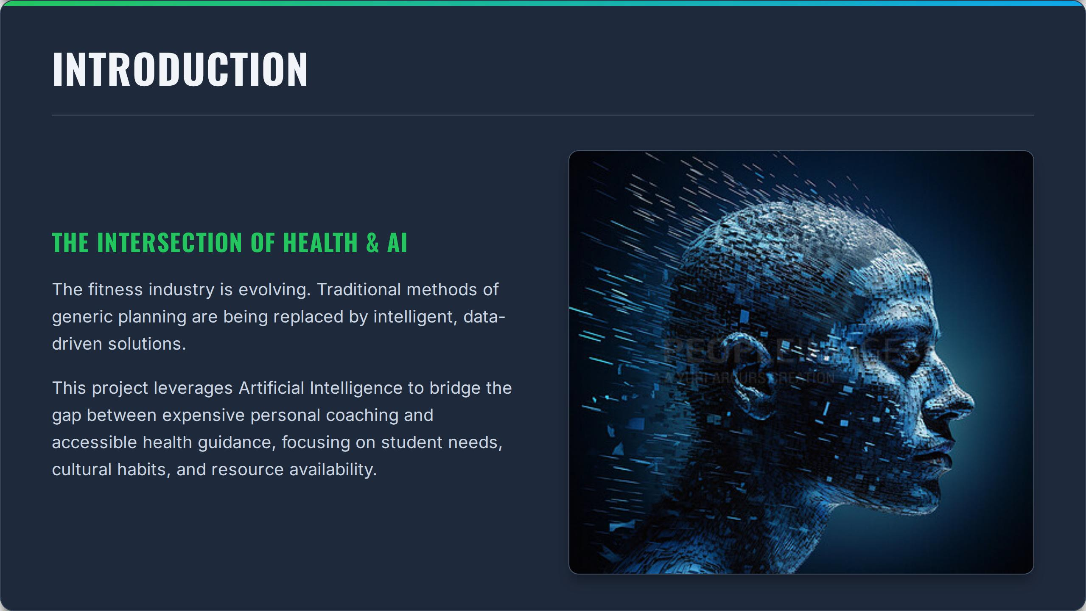

Slide 3
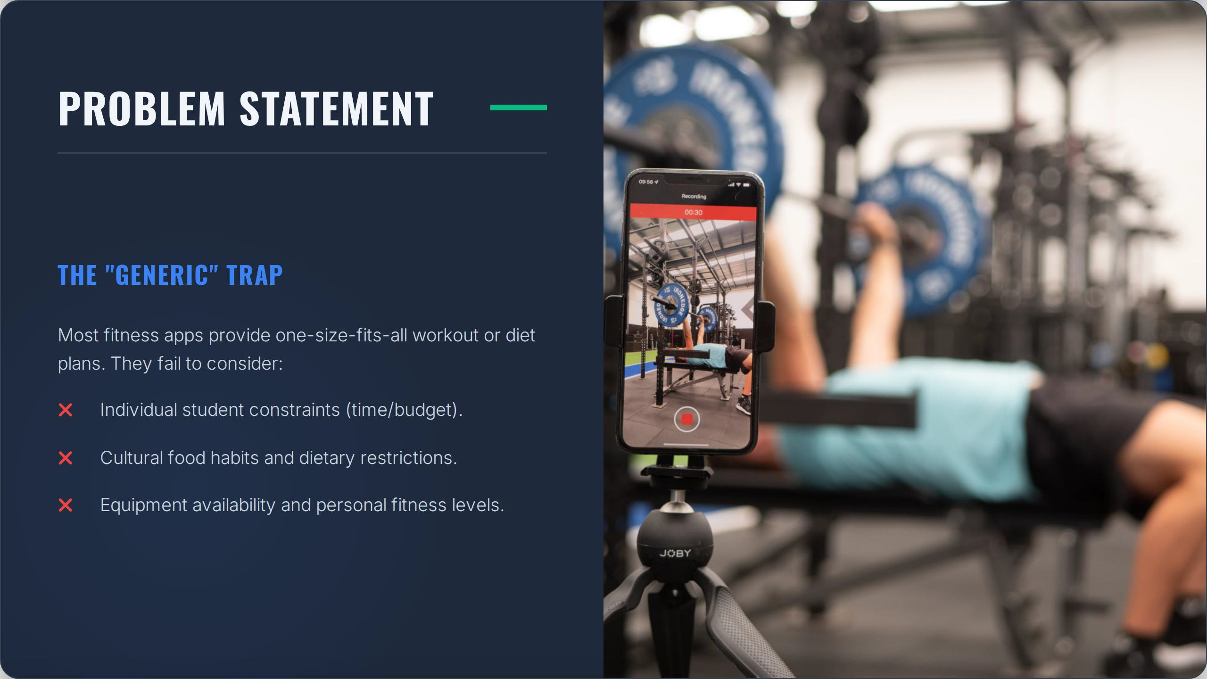

Slide 4
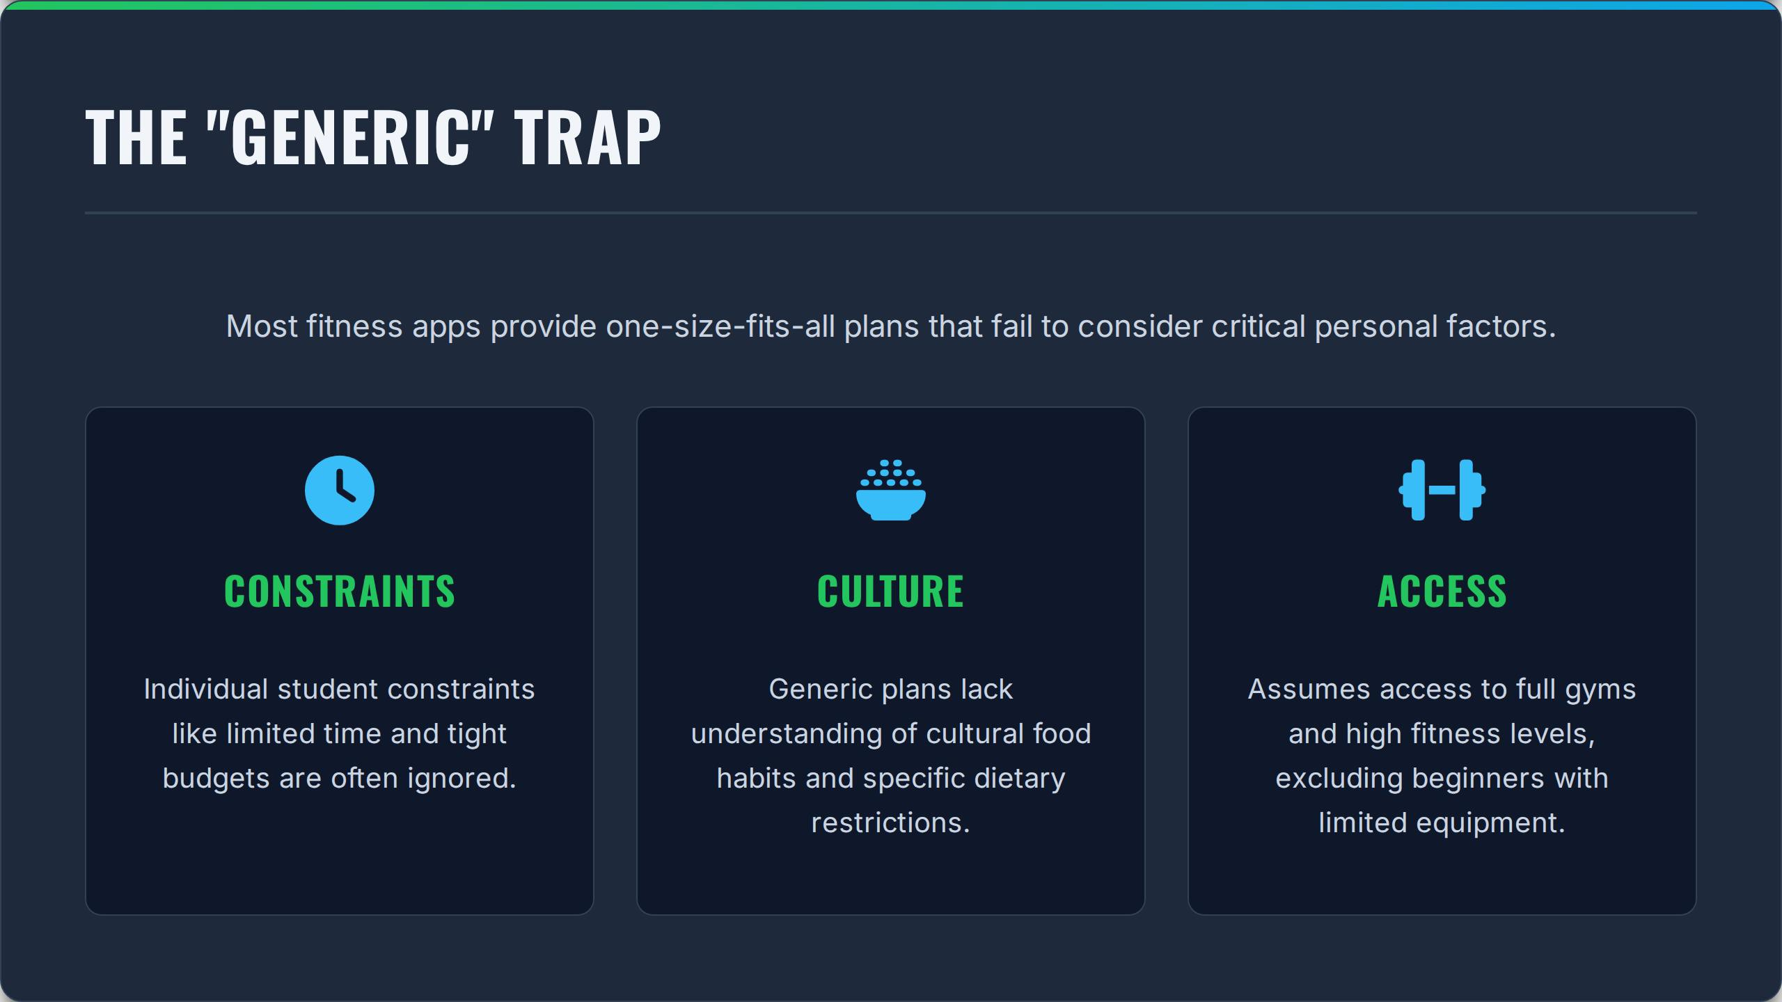

Slide 5
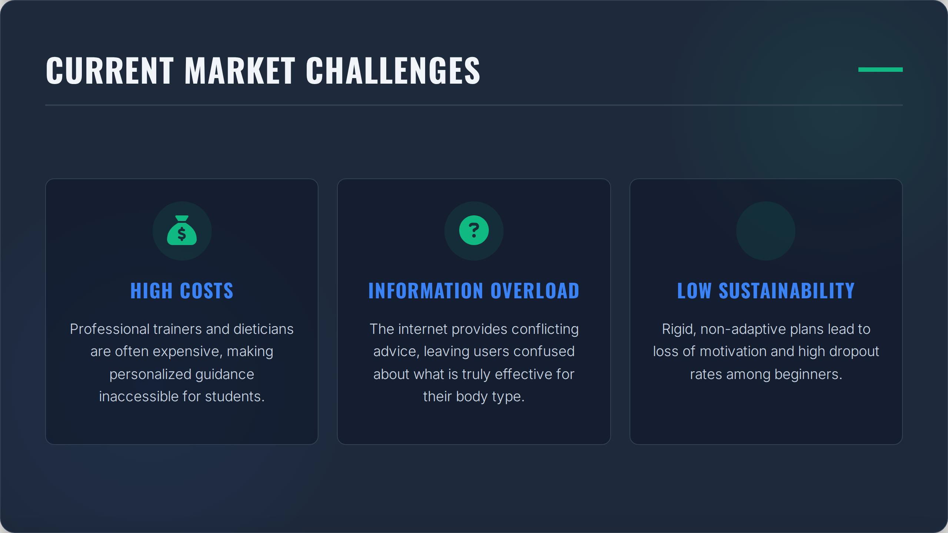

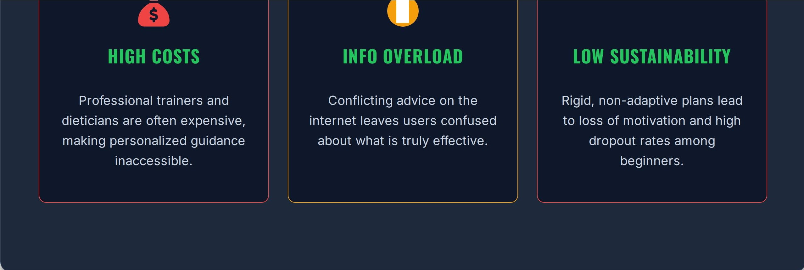
?
•

Slide 6
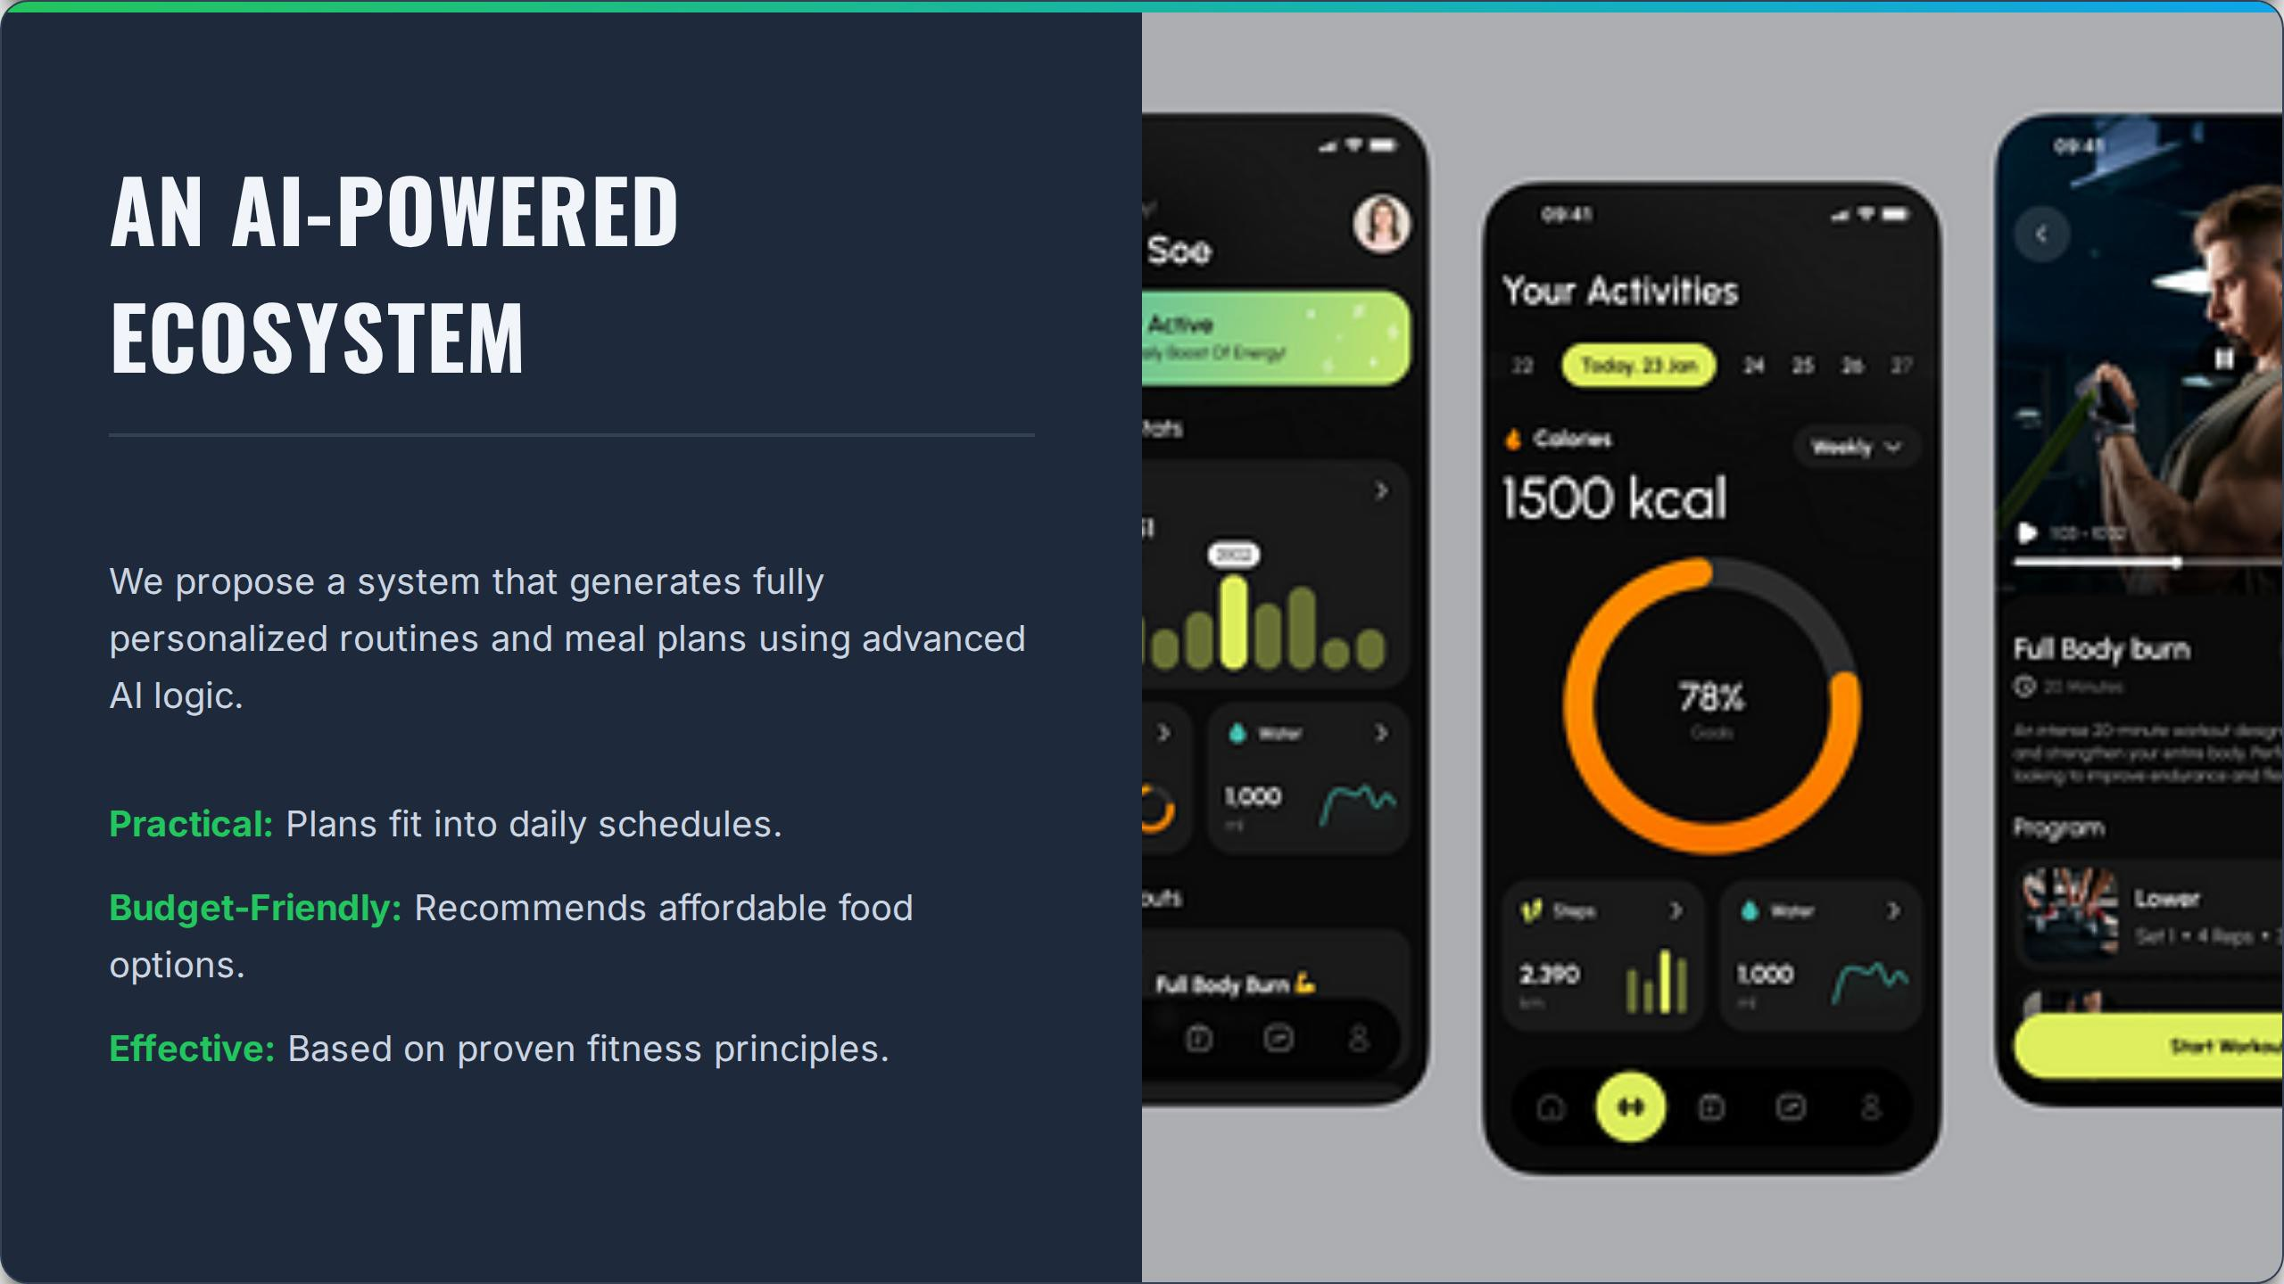

Slide 7
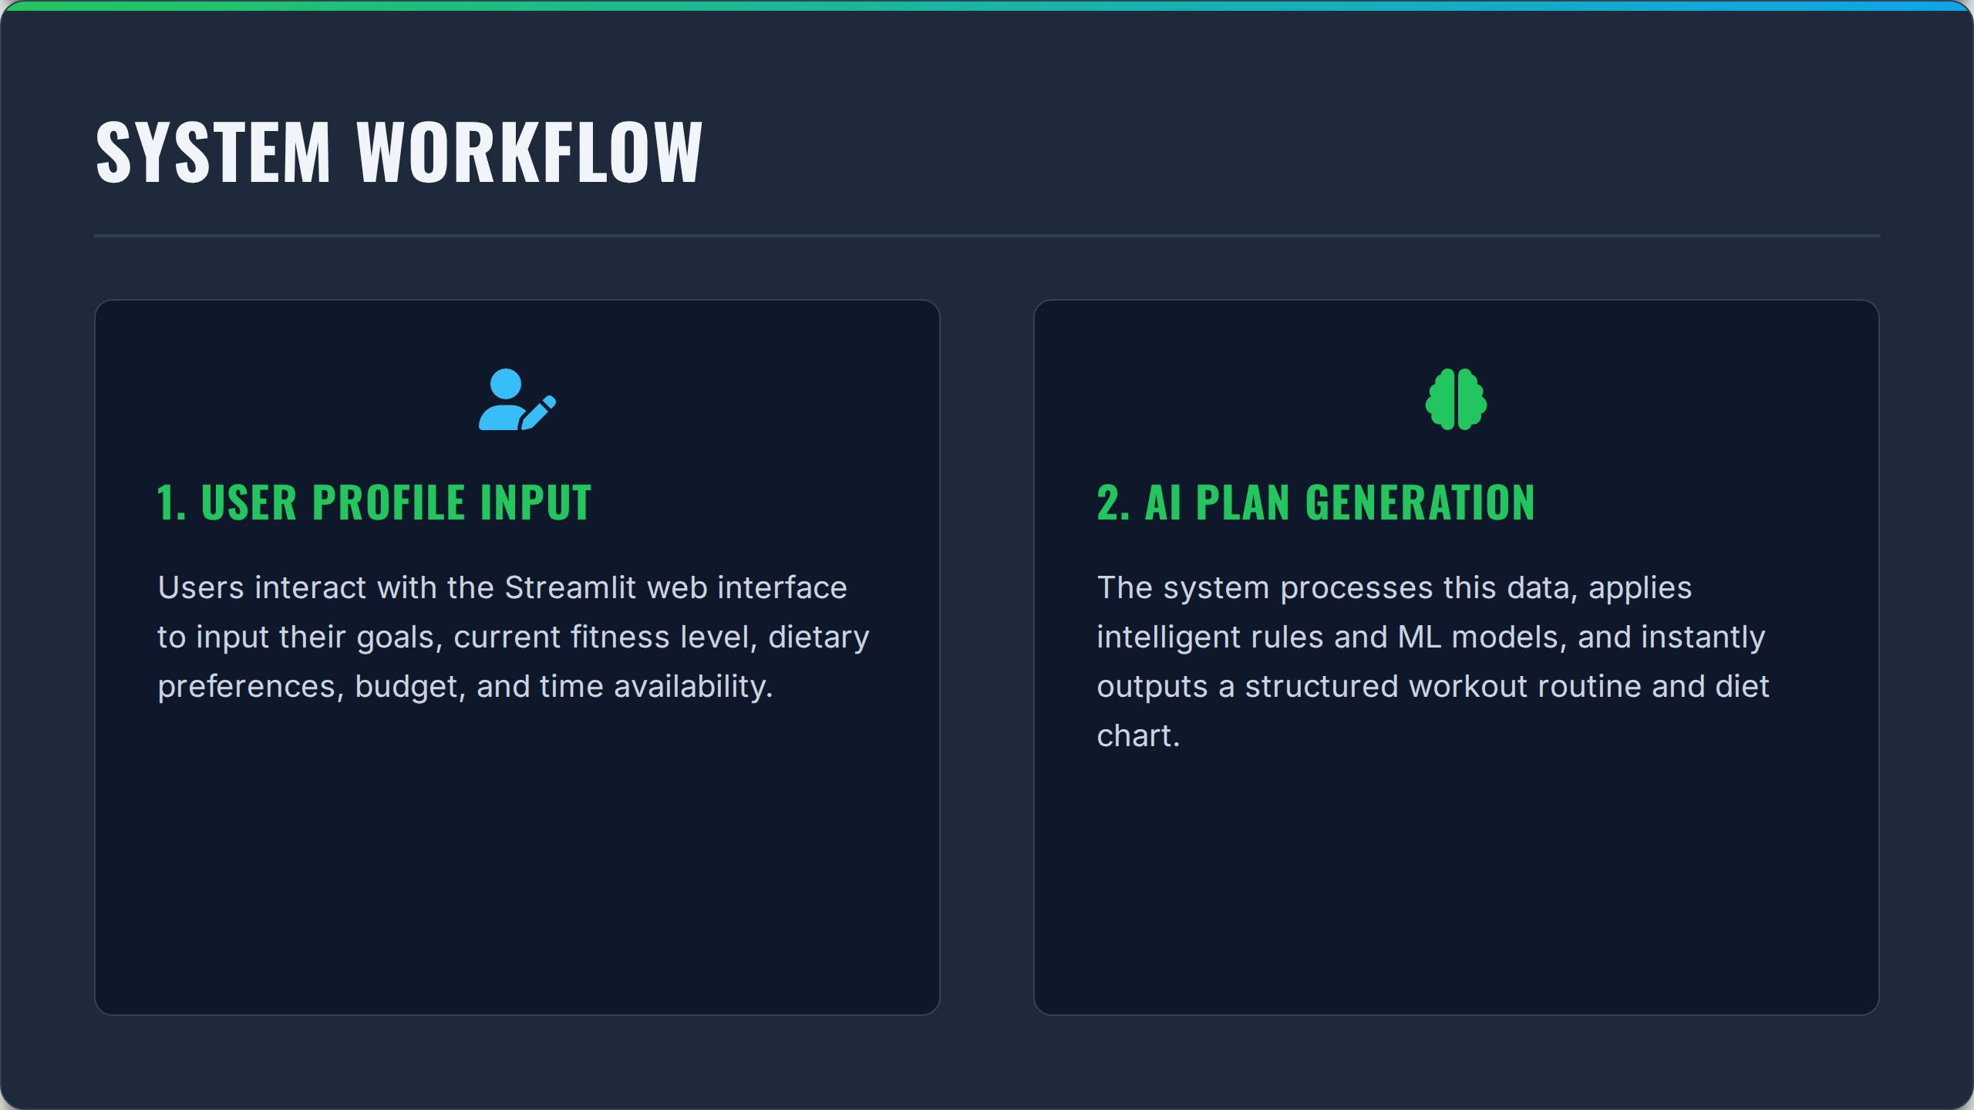

Slide 8
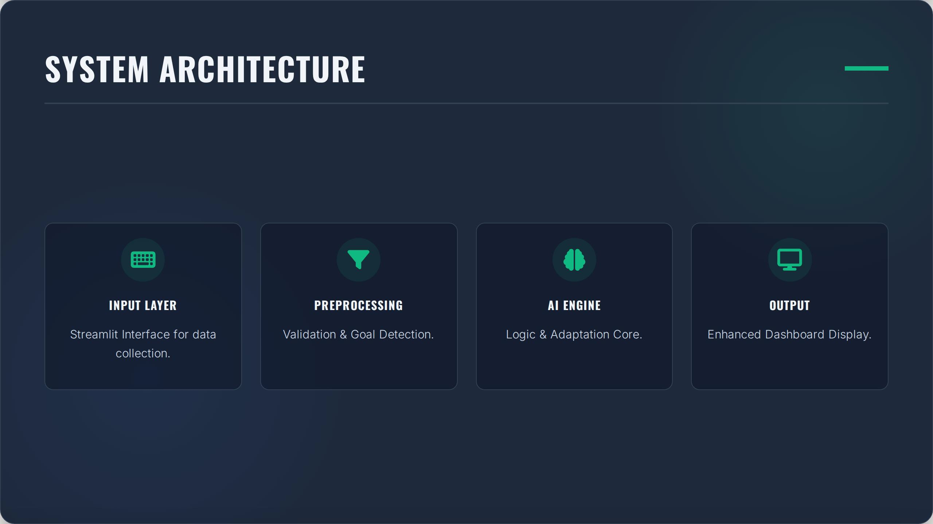

Slide 9
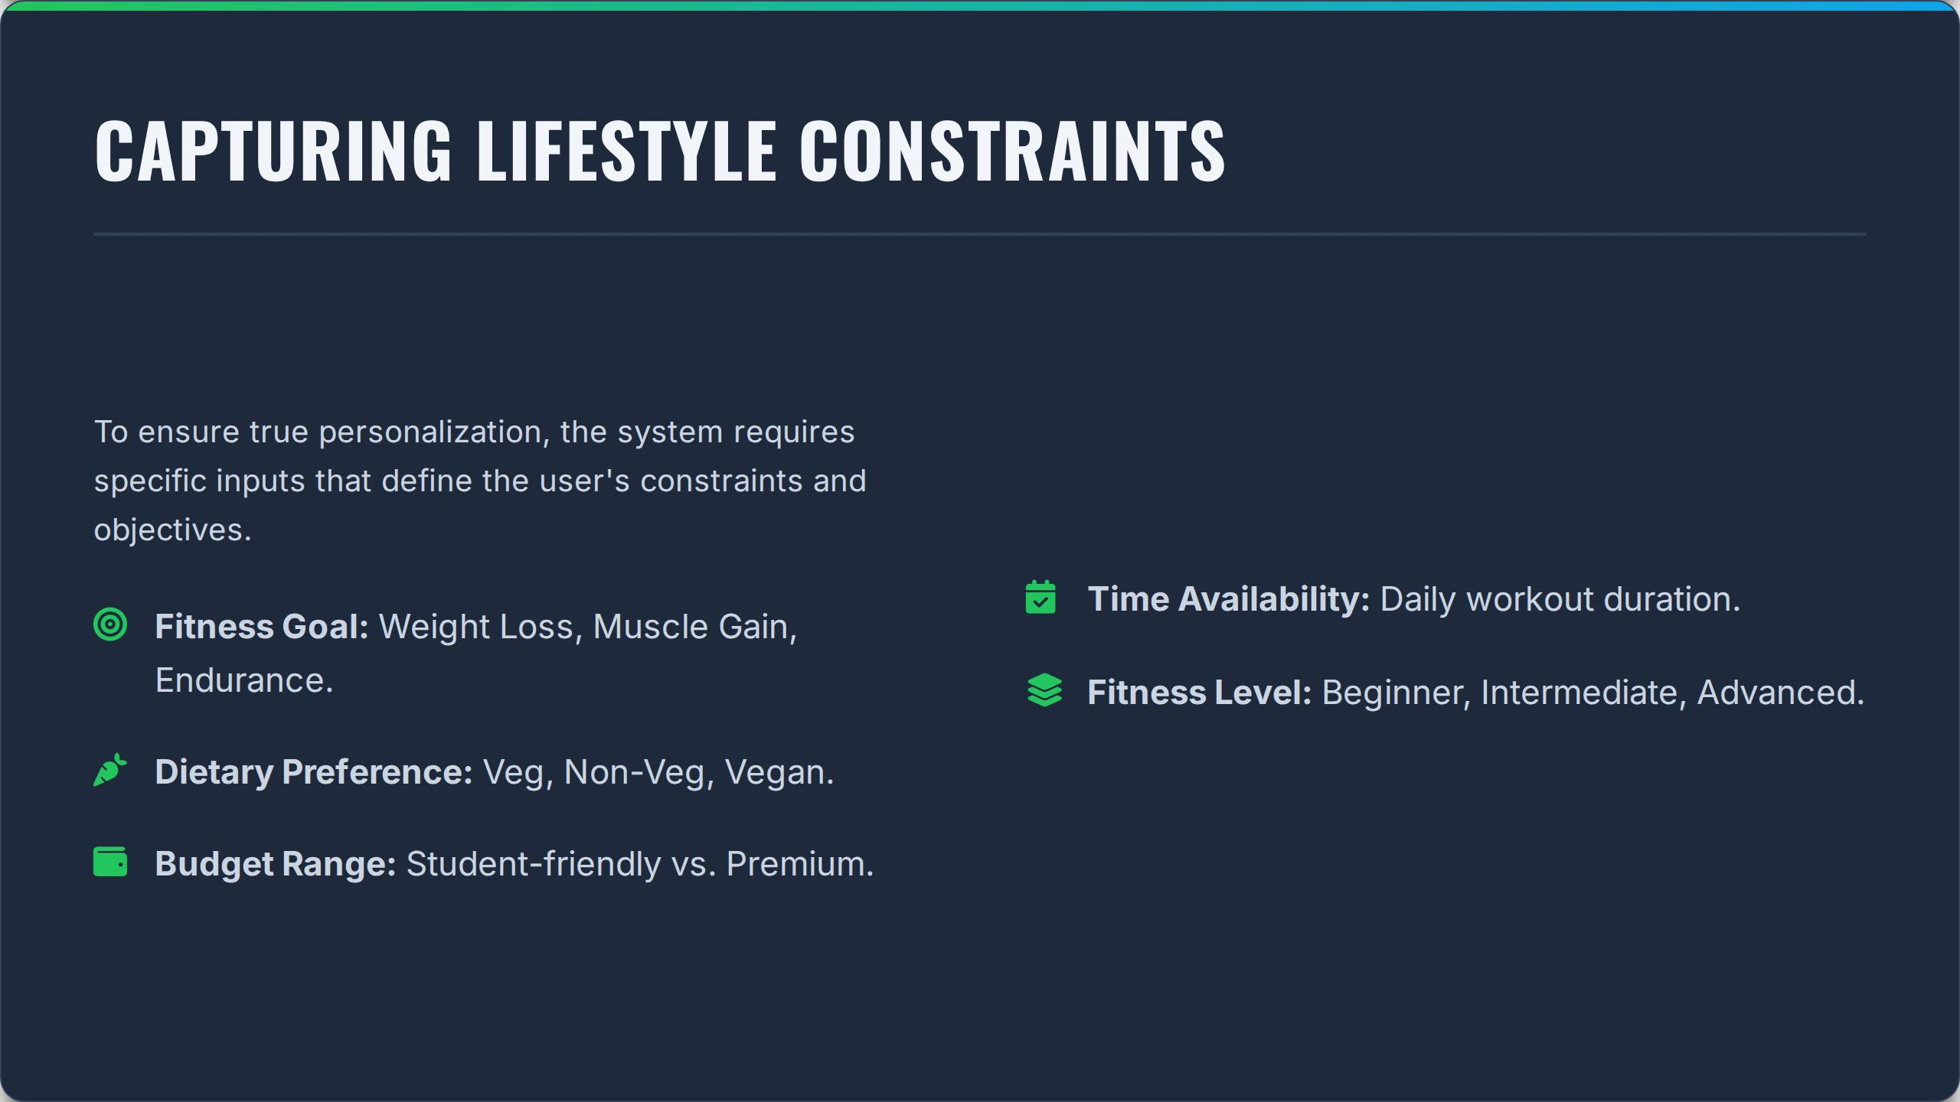

Slide 10
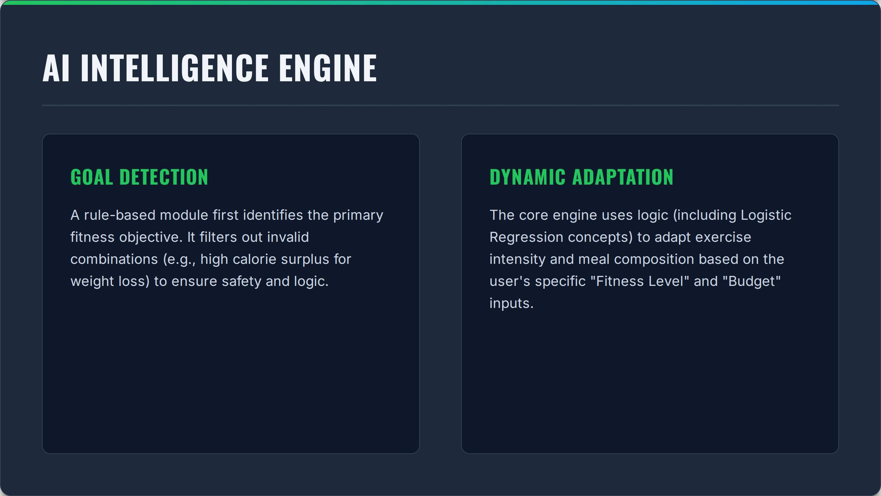

Slide 11
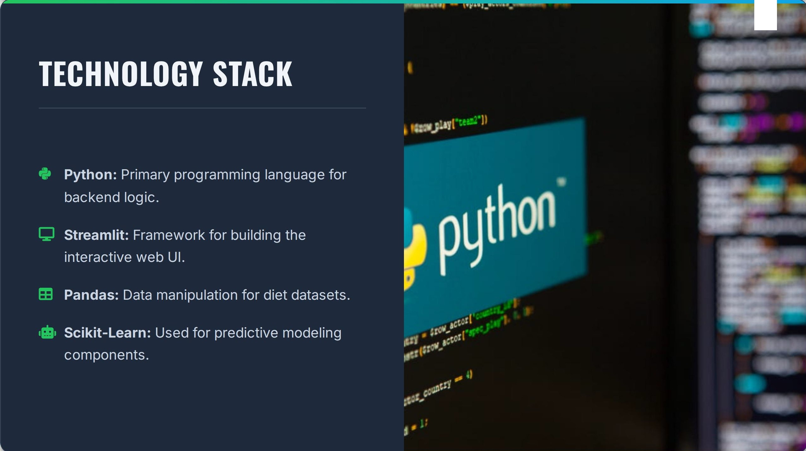

Slide 12
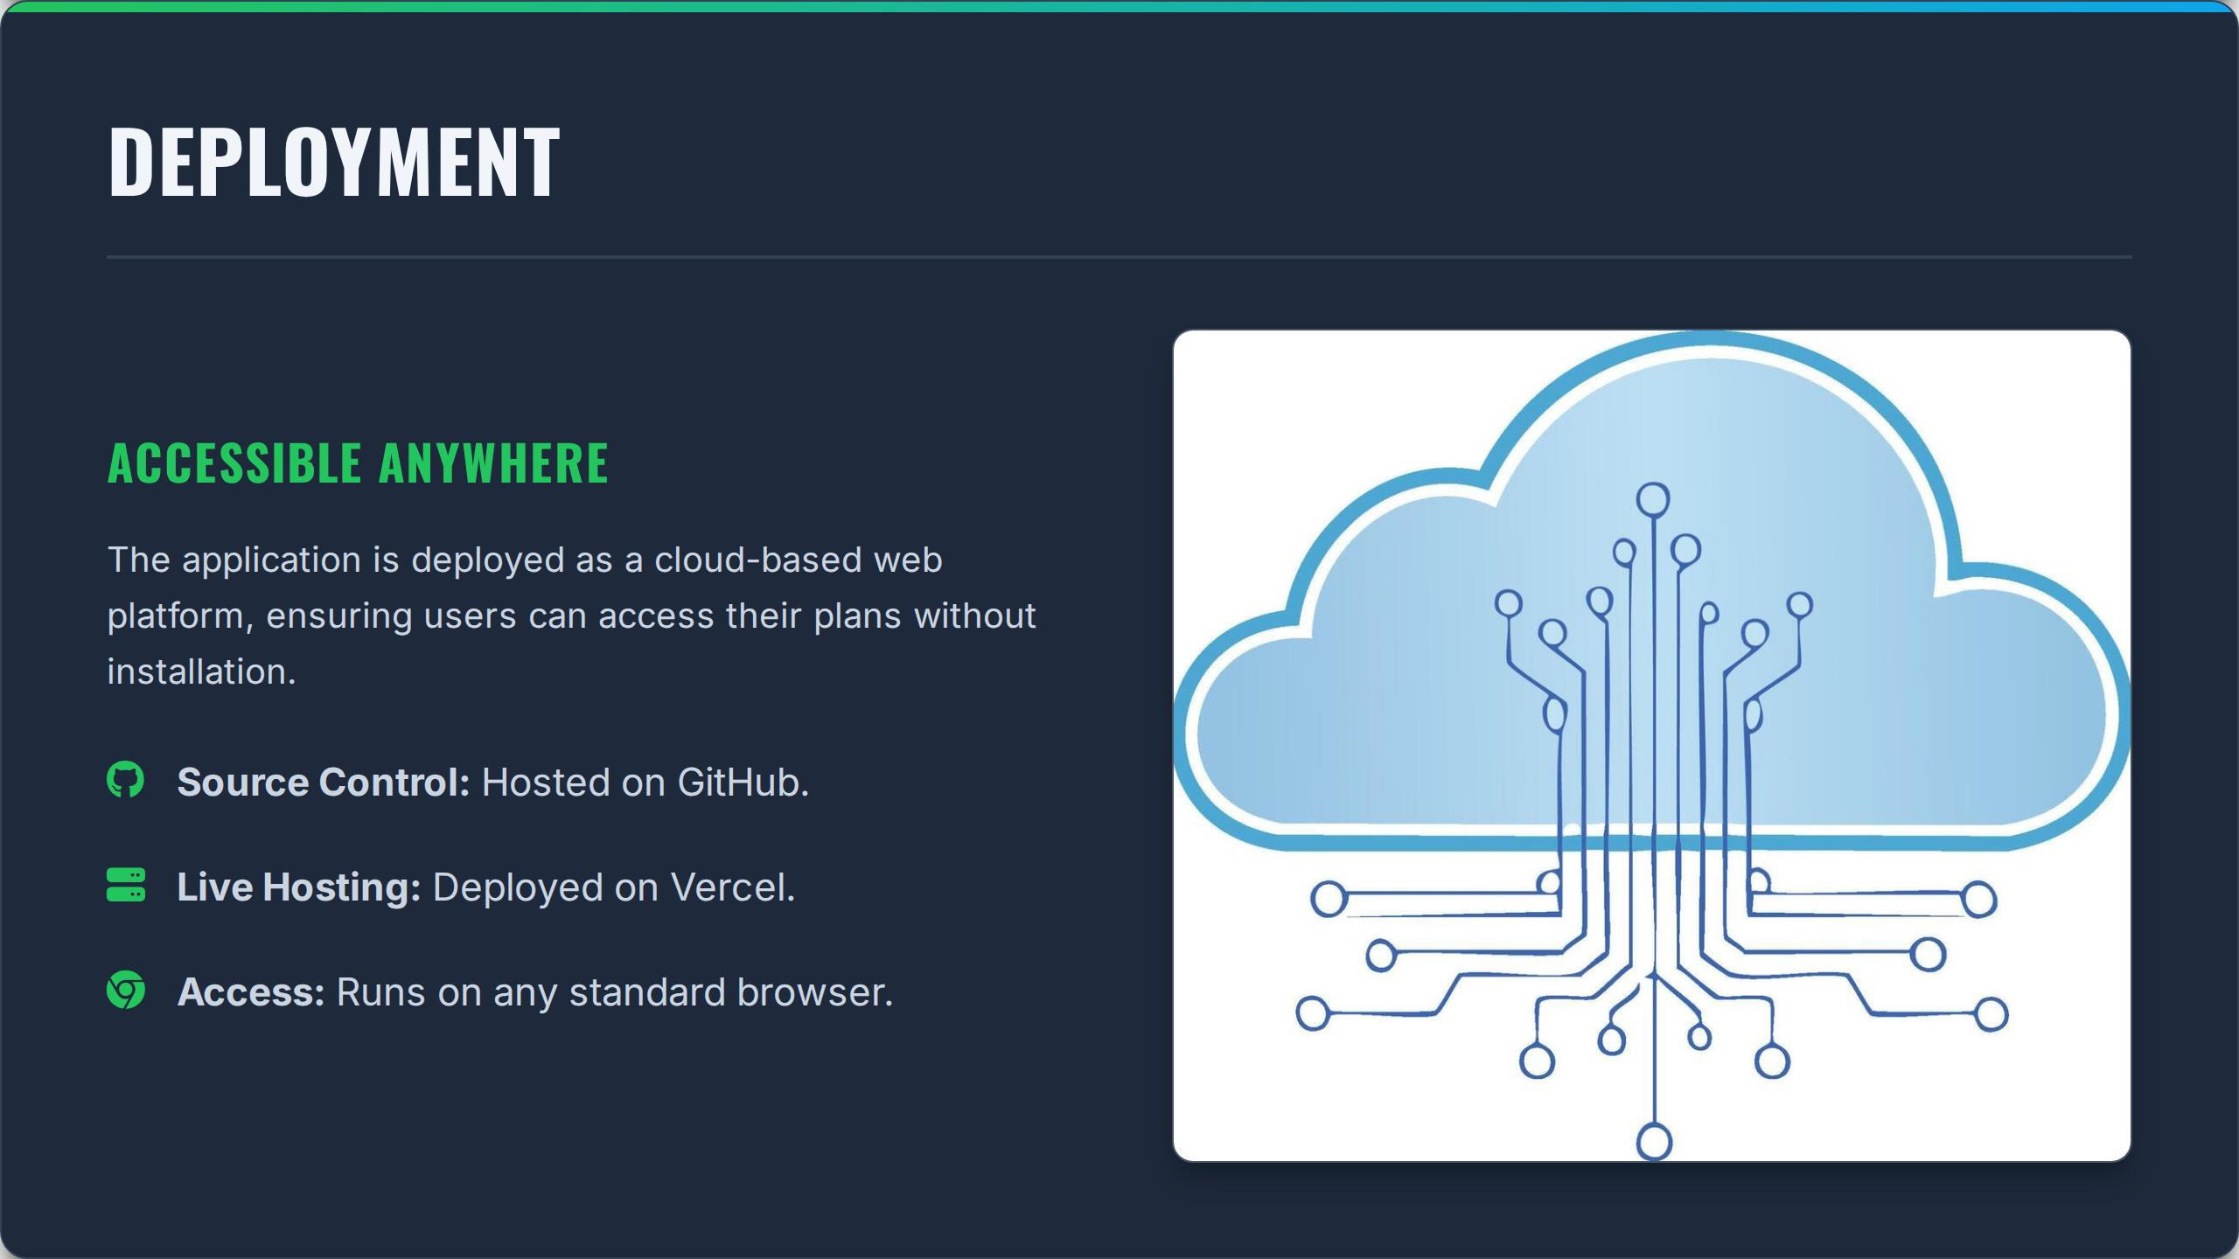

Slide 13
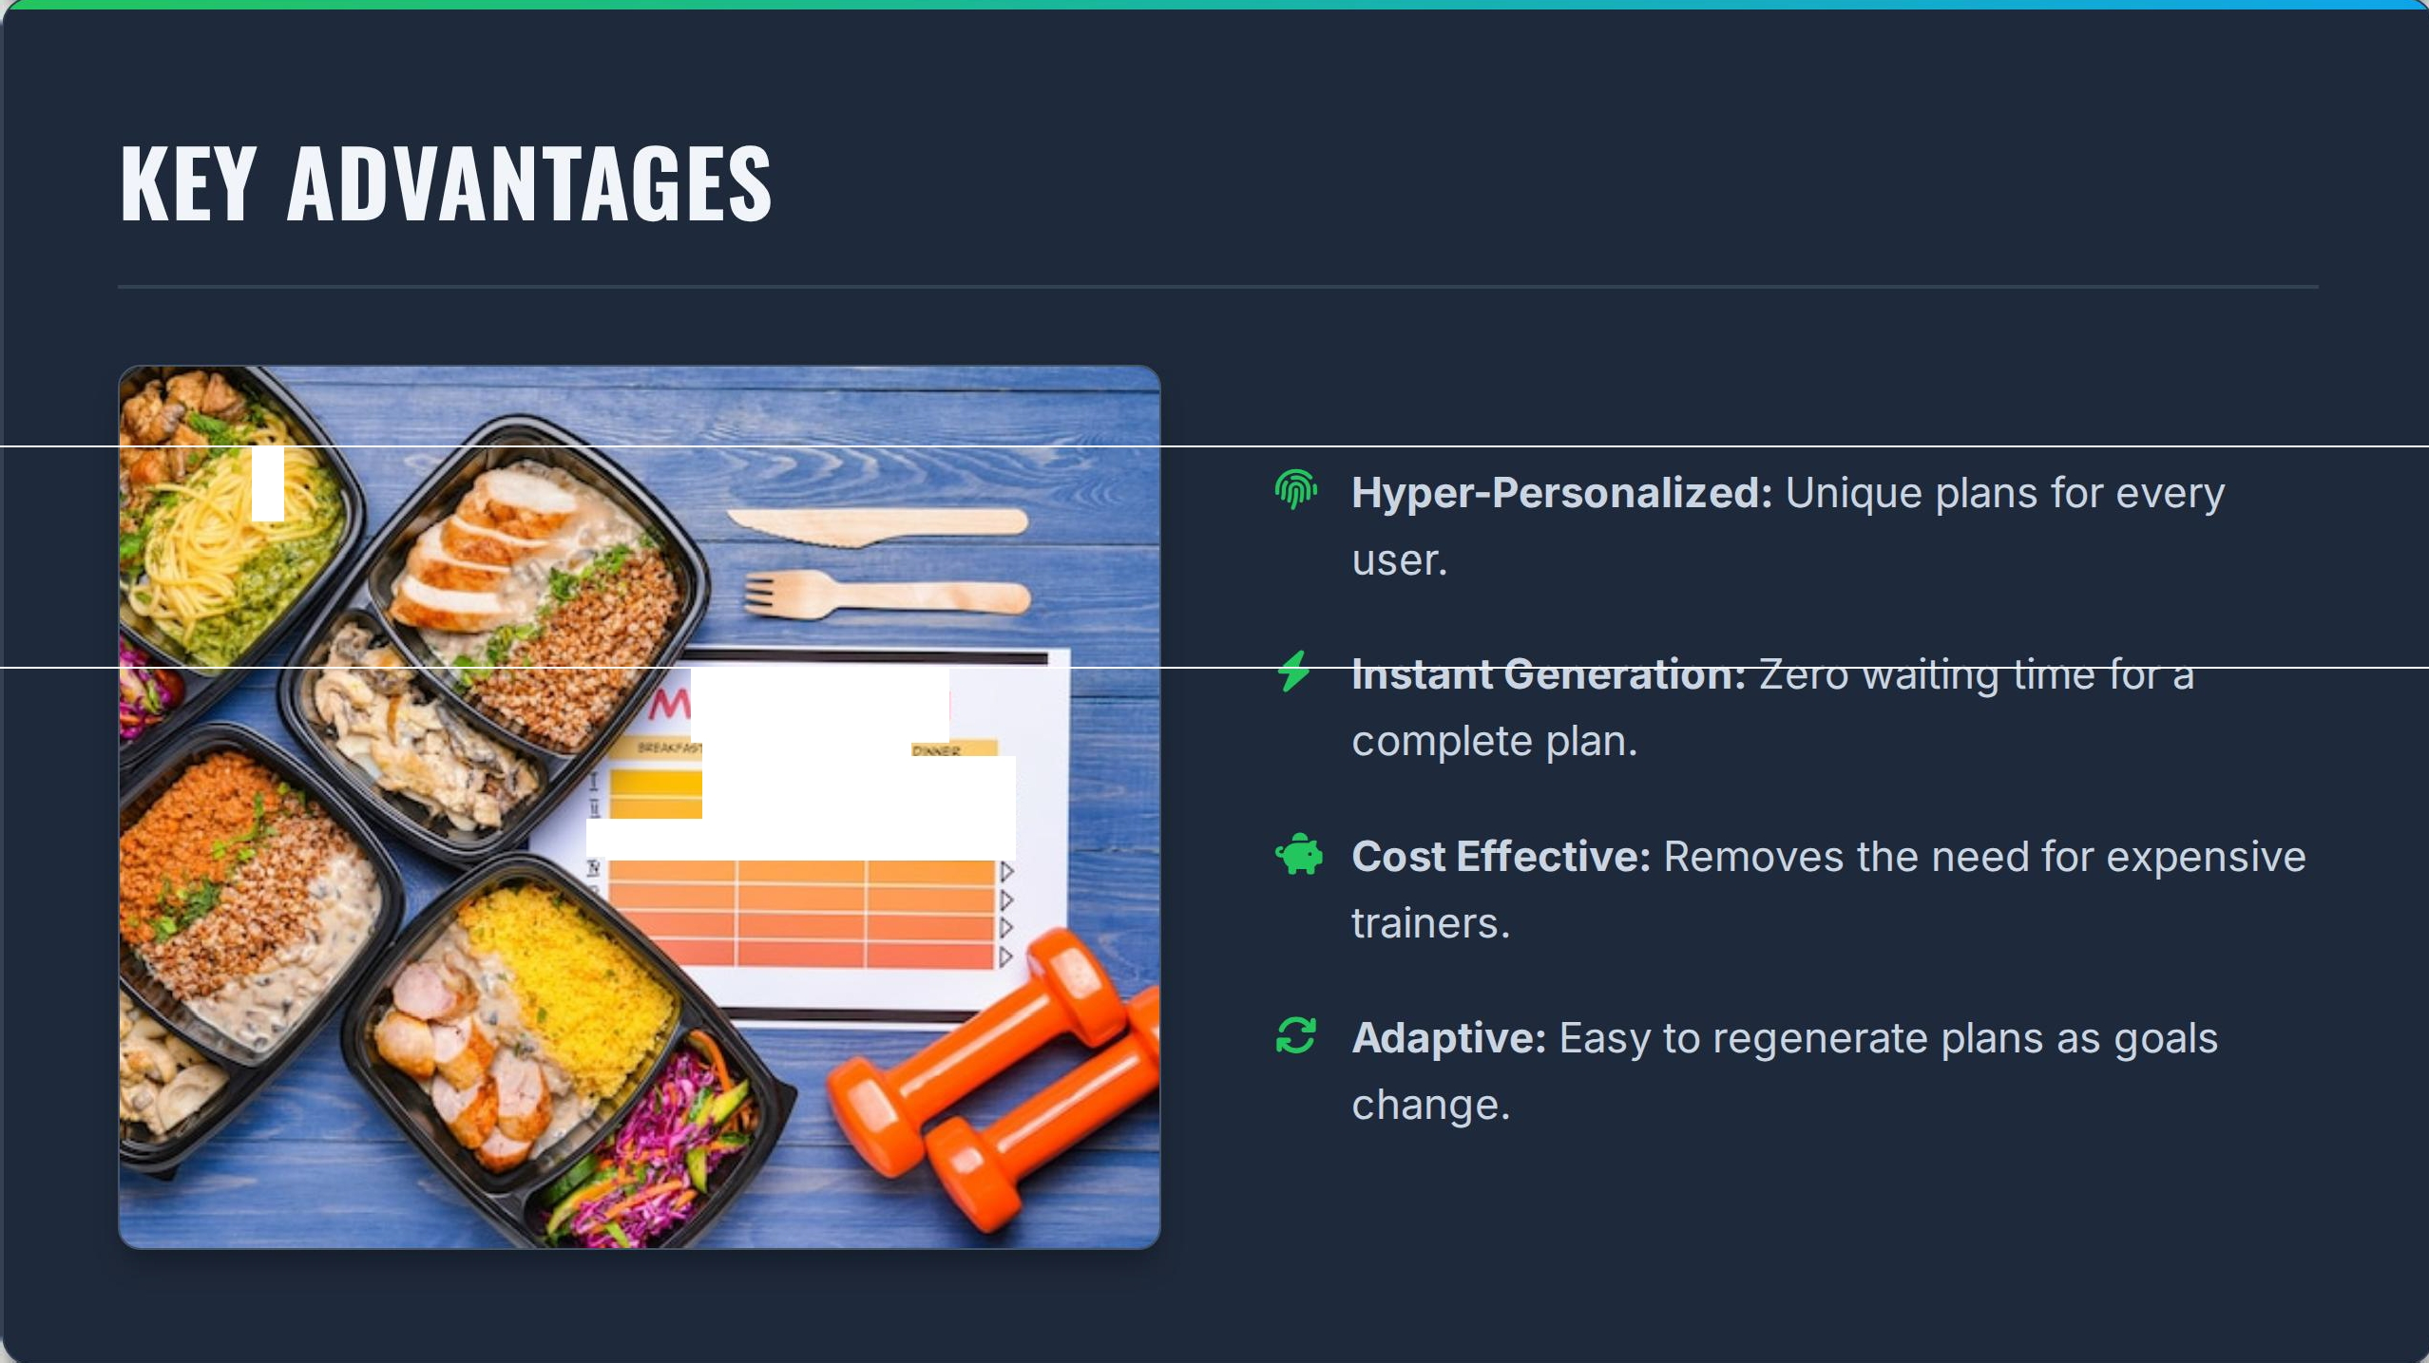
••
l
EAL PLAN
l. L
•
t> t> t>
!>
_{v}!>
�
)1
i===== =

Slide 14
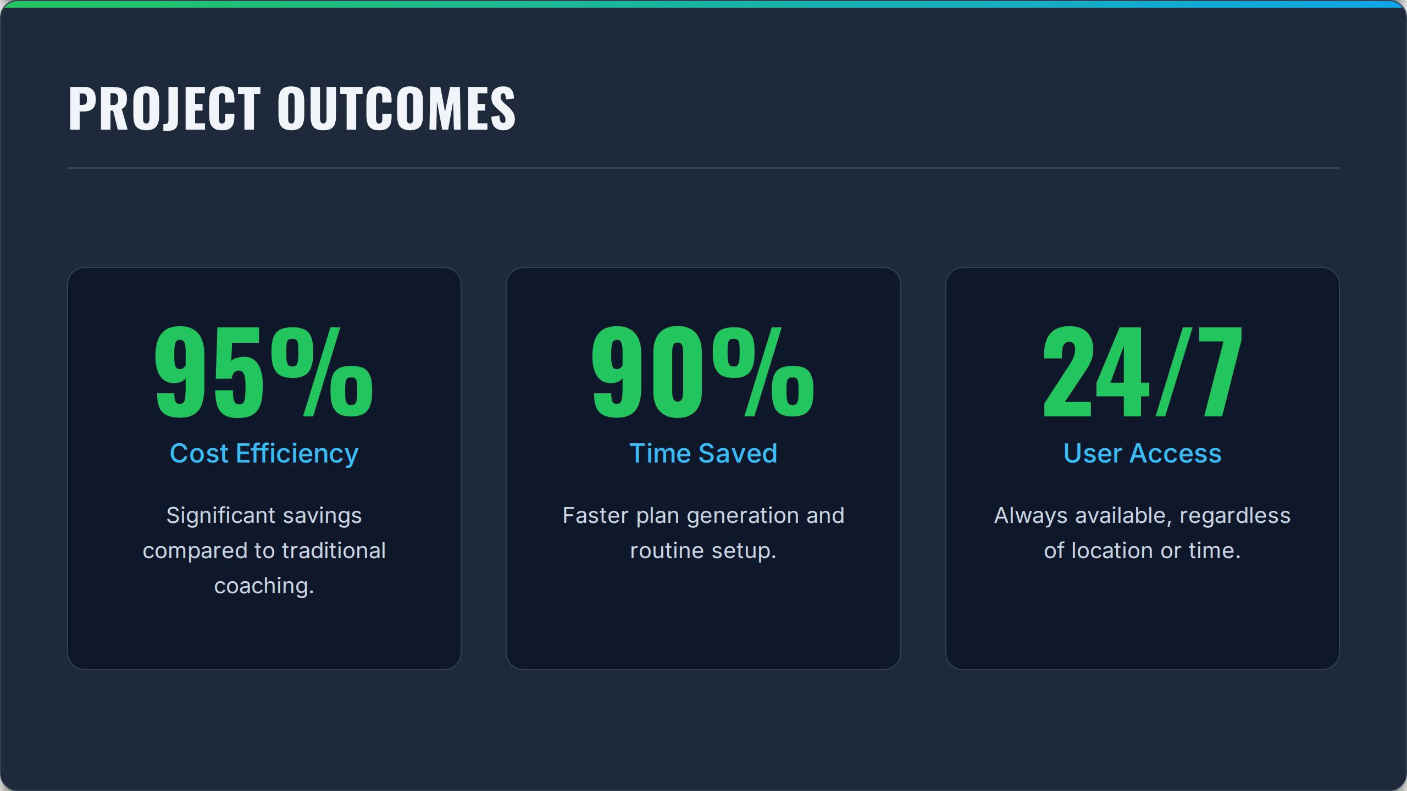

Slide 15
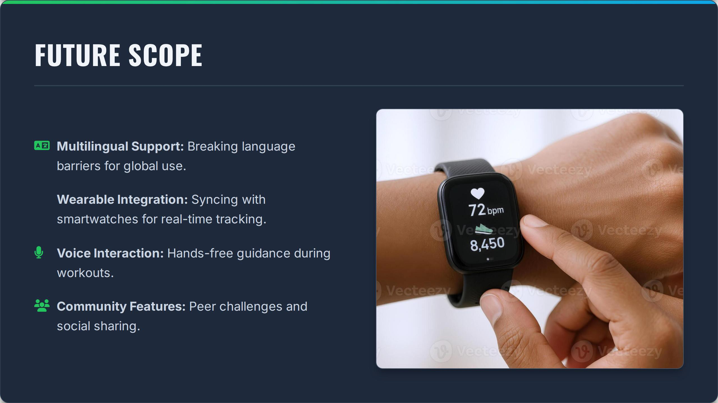

Slide 16
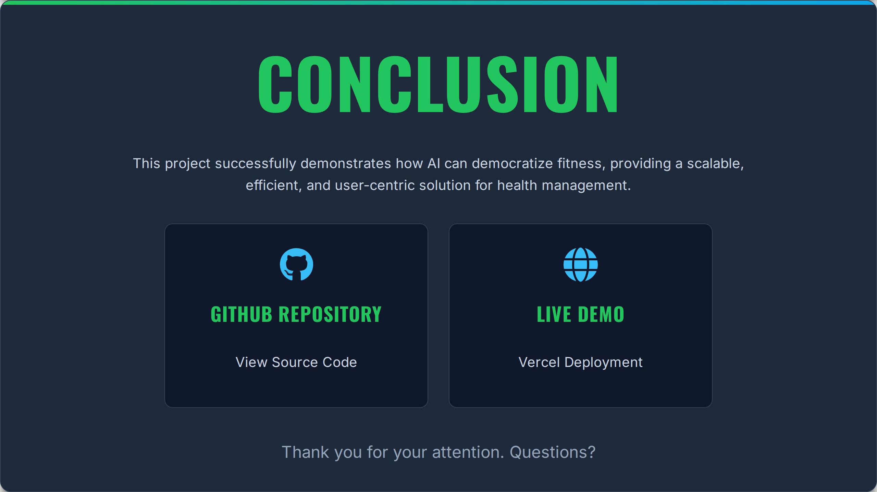
https://github.com/LalThota/ai-dietplanner.git
https://ai-dietplanner.vercel.app/

Slide 17
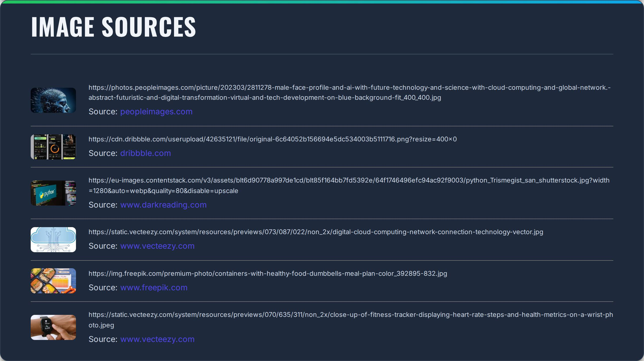

Slide 18
